Slide 1
Unistay
Testing screens

Slide 2

Unit testing

Slide 3
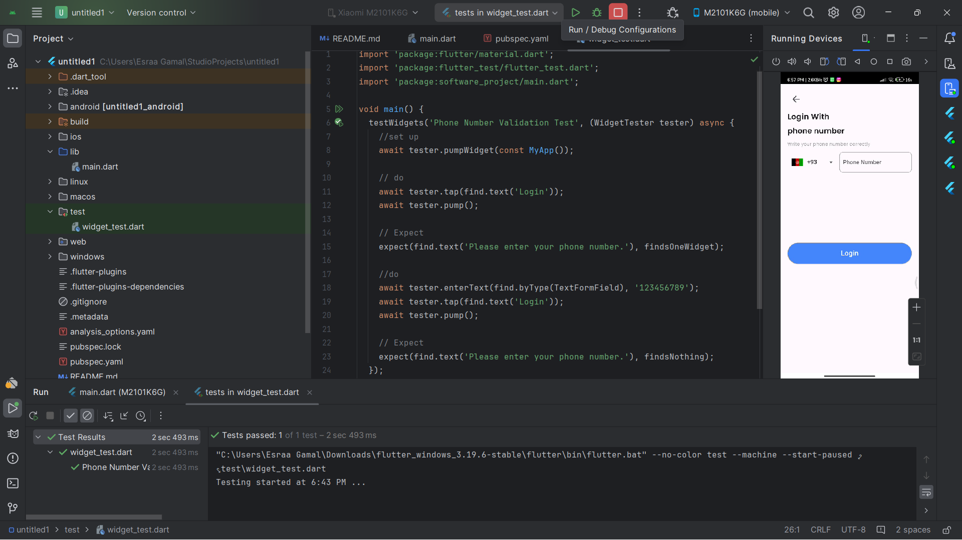
Unit Testing(Phone number validation class).

Slide 4
Performance Testing:

Slide 5
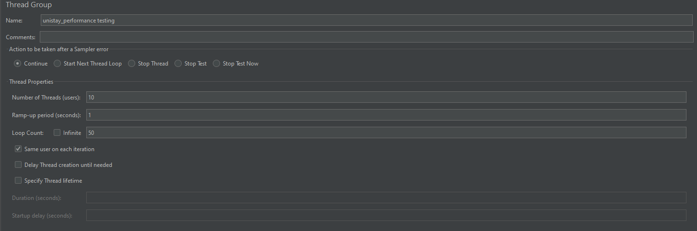
Performance Testing(preparing the thread) :

Slide 6
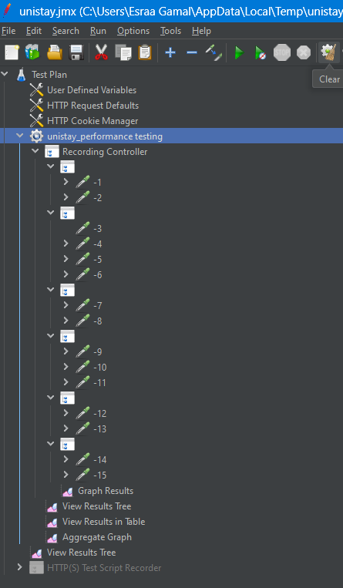
Performance Testing cont.:
(Recording app interactions)

Slide 7

Show Results (In a tree):

Slide 8
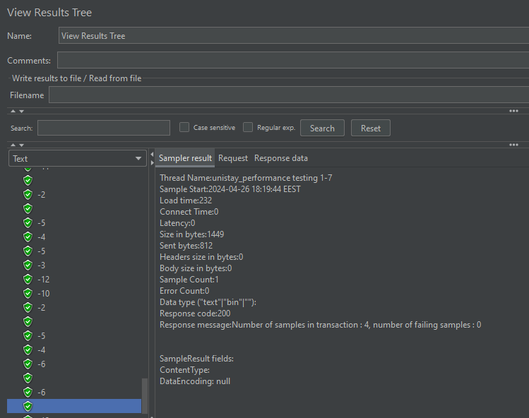
Show Results (In a tree):

Slide 9

Show Results (In a graph):

Slide 10
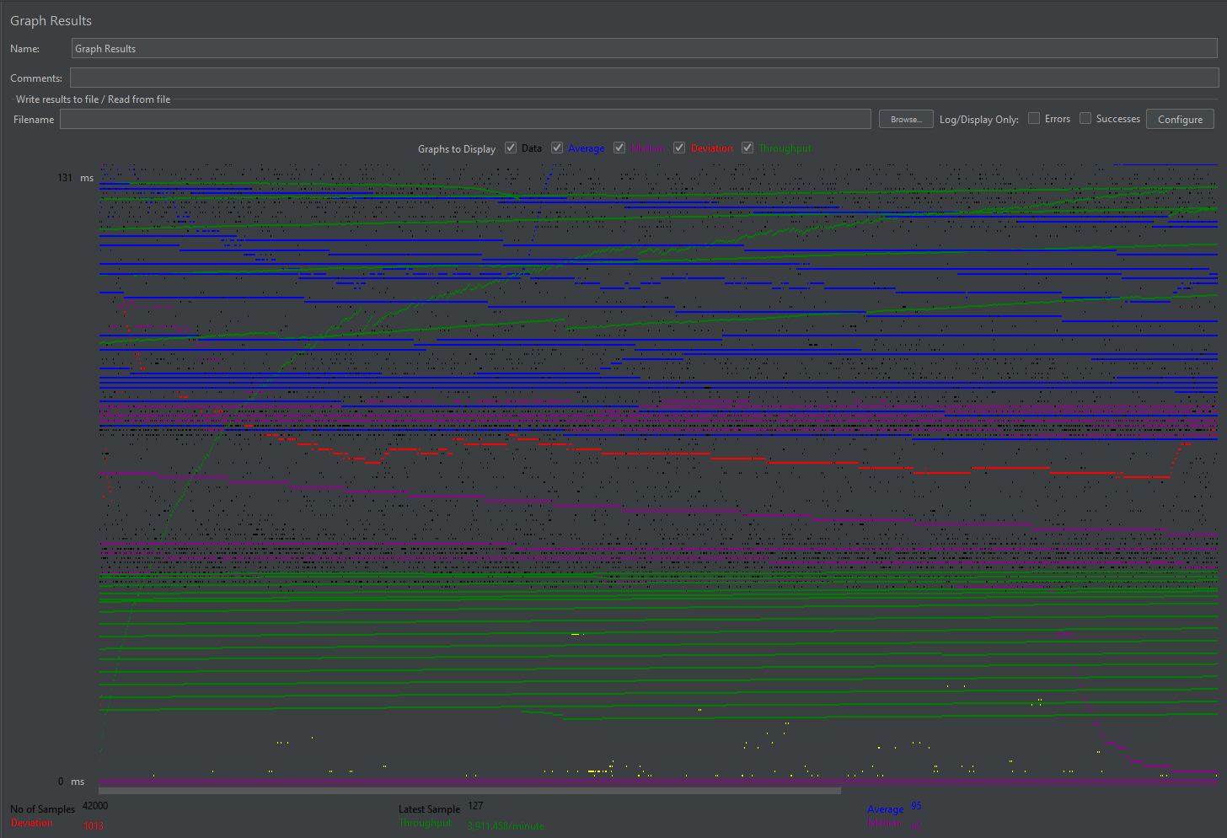
Show Results (In a graph):

Slide 11

Show Results (In a table):

Slide 12
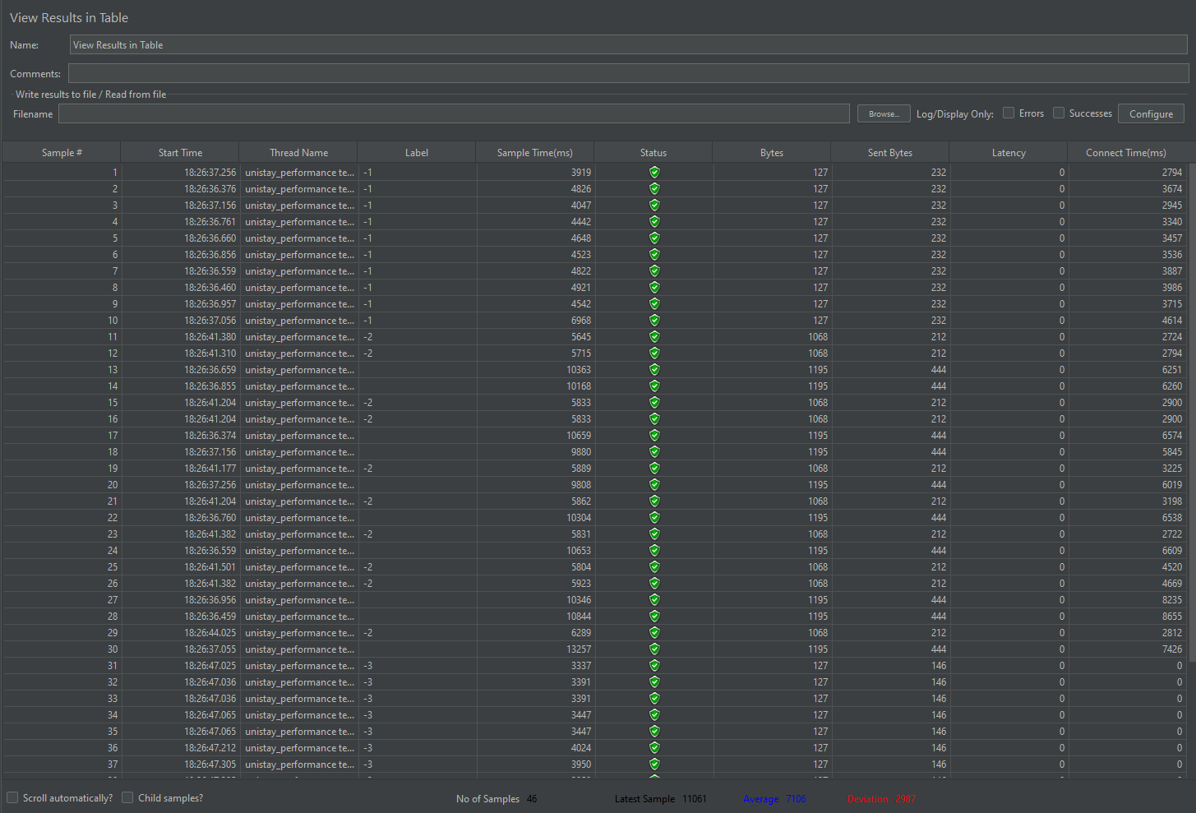
Show Results (In a table):

Slide 13
Show Results (In an aggregate graph):

Slide 14
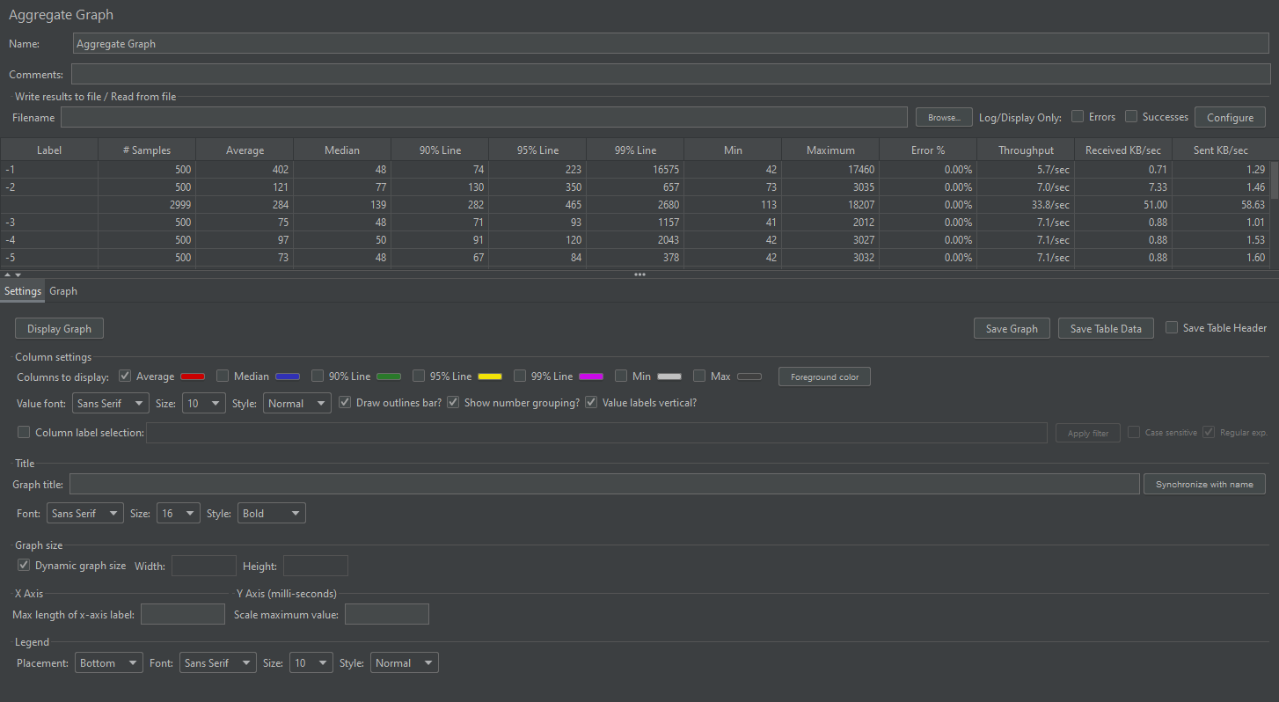
Show Results (In an aggregate graph):

Slide 15

Thank You!

